Slide 1

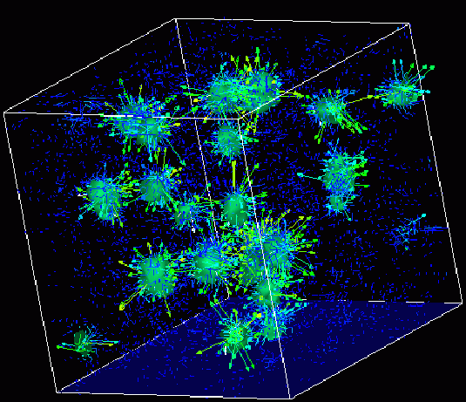
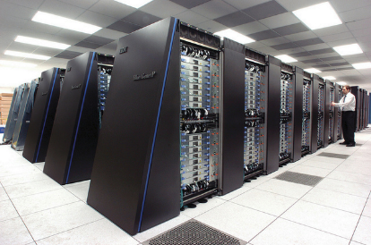
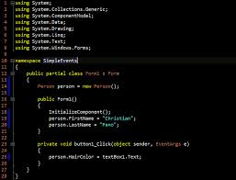
Survey of
Scientific Computing
(SciComp 301)
Dave Biersach
Brookhaven National Laboratory
dbiersach@bnl.gov
Exam 2
Total of 100 points

Slide 2




5 pts
1. Solve a given 4x4 system
In the q01 folder, edit the C++ console application to calculate the four unknowns for this system of equations:
$$x_{1}+2x_{2}+x_{3}−x_{4}=5$$
$${3x}_{1}+2x_{2}+4x_{3}+4x_{4}=16$$
$$4x_{1}+4x_{2}+3x_{3}+4x_{4}=22$$
$$2x_{1}+x_{3}+5x_{4}=15$$

Slide 3
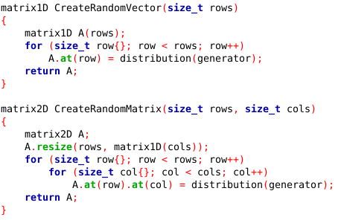
15 pts
2. Create and solve a random 10x10 system
In the q02 folder, edit the C++ console application to generate and solve a system of 10 random linear equations having 10 unknowns using Cramer’s Rule
The coefficients and values should be taken from a uniform real distribution between [-10,10) with initial seed of 2016
Display all numbers with four digits of precision to the right of the decimal point
Copy the two helper functions shown on the right to initialize the coeffMatrix and the valueVector variables in main()

Slide 4
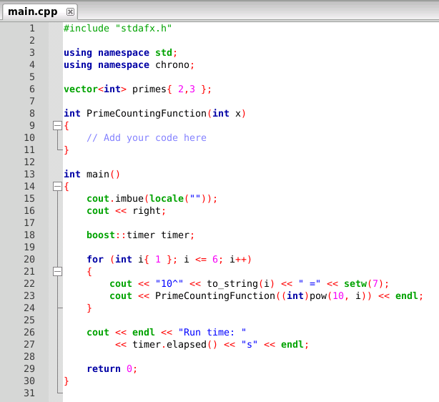
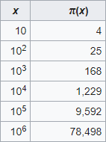
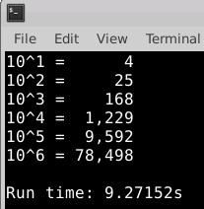
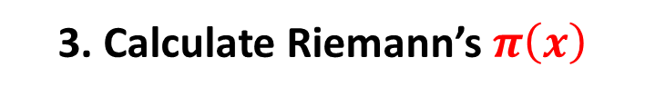
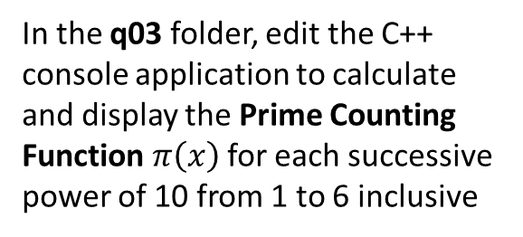
20 pts
3. Calculate Riemann’s $π\left(x\right)$
In the q03 folder, edit the C++ console application to calculate and display the Prime Counting Function $π\left(x\right)$ for each successive power of 10 from 1 to 6 inclusive
You must write this function
Special bonus points if your code runs faster than mine!

Slide 5
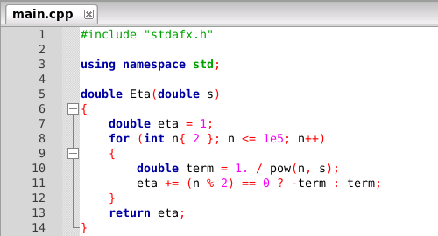
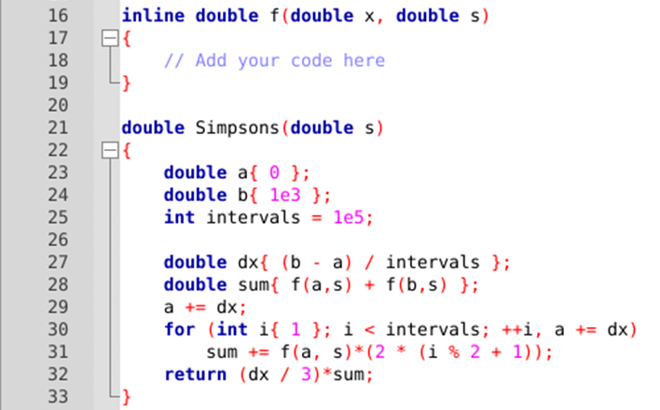
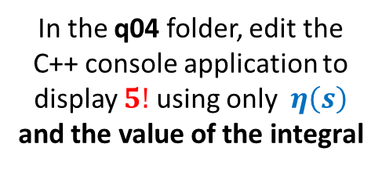
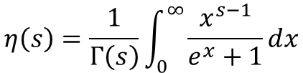
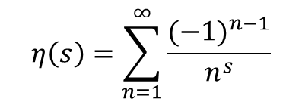
10 pts
4. Calculate Gamma from Eta
$$η\left(s\right)=\sum_{n=1}^{∞}{\frac{{(−1)}^{n−1}}{n^{s}}}$$
$$η\left(s\right)=\frac{1}{Γ\left(s\right)}\int_{0}^{∞}{\frac{x^{s−1}}{e^{x}+1}ⅆx}$$
In the q04 folder, edit the C++ console application to display $5!$ using only $η\left(s\right)$ and the value of the integral

Slide 6
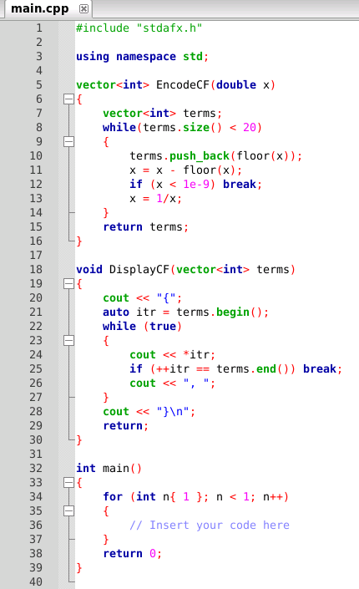
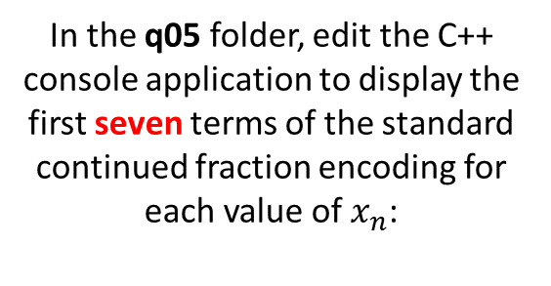
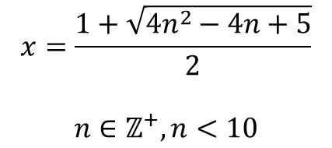
15 pts
5. Expand a Standard CF
In the q05 folder, edit the C++ console application to display the first seven terms of the standard continued fraction encoding for each value of $x_{n}$:
$$x=\frac{1+\sqrt{4n^{2}−4n+5}}{2}$$
$$n∈ℤ^{+}, n<10$$

Slide 7
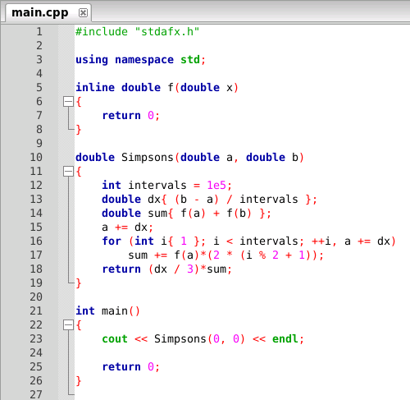
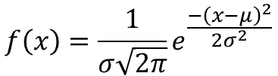
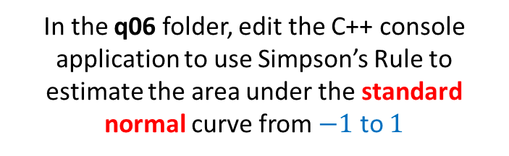
10 pts
6. Integrate the Standard Normal
In the q06 folder, edit the C++ console application to use Simpson’s Rule to estimate the area under the standard normal curve from $−1$ to $1$
$$f\left(x\right)=\frac{1}{σ\sqrt{2π}}e^{\frac{−{\left(x−μ\right)}^{2}}{2σ^{2}}}$$
Is this area the same as the probability of a normally distributed random variable falling within the first standard deviation away from the mean?

Slide 8
5 pts
7. Decrypt Ciphertext
In the q07 folder, edit the C++ console application to decrypt the file ciphertext2.txt
To get started, execute the CERN ROOT code
from Session 14 Lab 2

Slide 9
10 pts
8. Finding an Open Reading Frame (ORF)
https://en.wikipedia.org/wiki/Open_reading_frame
http://vlab.amrita.edu/?sub=3&brch=273&sim=1432&cnt=1
DNA (Deoxyribonucleic acid) is the genetic material that contains all the genetic information in a living organisms. The information is stored as genetic codes using adenine (A), guanine (G), cytosine(C) and thymine (T). During the transcription process, DNA is copied to mRNA. Each of these base pairs will bond with a sugar and phosphate molecule to form a nucleotide. Three nucleotides that code for a particular amino acid during translation is called as a codon. An Open Reading Frame (ORF) goes from the start codon to a stop codon and encodes a specific protein. By analyzing the ORF we can predict the possible amino acids that might be produced during translation.
Given a sequence, create 6 different reading frames labeled +1, +2, +3, -1, -2 and -3:
The first reading frame is obtained by considering the sequence in words of 3
The second reading frame is formed after skipping the first nucleotide and then grouping the remaining sequence into words of 3 nucleotides
The third reading frame is formed after skipping the first 2 nucleotides and then grouping the remaining sequence into words of 3 nucleotides
The other negative 3 reading frames can be found only after finding the reverse complement of the sequence
The same process as for the +1, +2 and +3 strands is repeated for the -1, -2 and -3 strands, but now using the reverse complement sequence
To identify each open reading frame (ORF):
Find the start codon and stop codons in each reading frame
Display the sequence stretch beginning with a start codon and ending in a stop codon

Slide 10
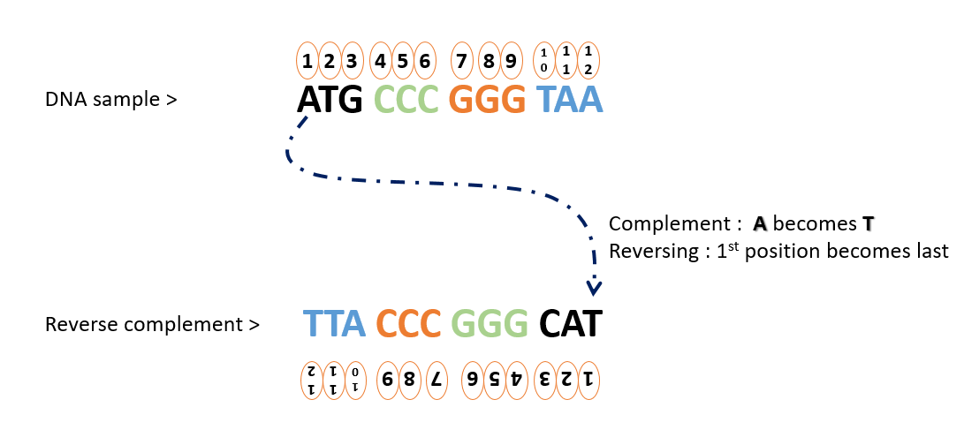
10 pts
8. Finding an Open Reading Frame (ORF)

Slide 11
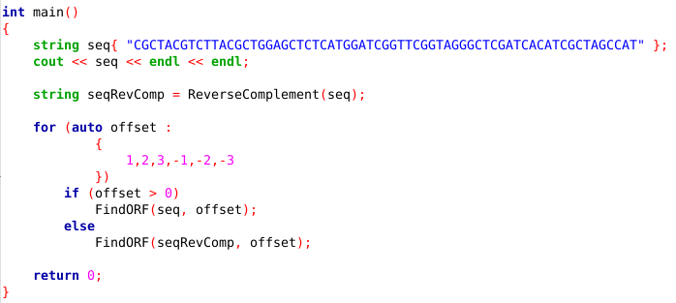
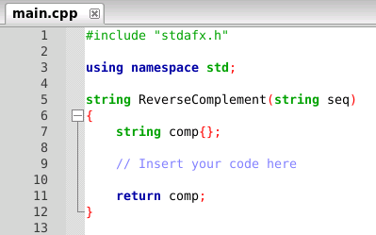
8. Finding an Open Reading Frame (ORF)
http://vlab.amrita.edu/?sub=3&brch=273&sim=1432&cnt=1
You must write this function
In the q08 folder, edit the existing C++ console application to generate the reverse complement of a given DNA sequence

Slide 12
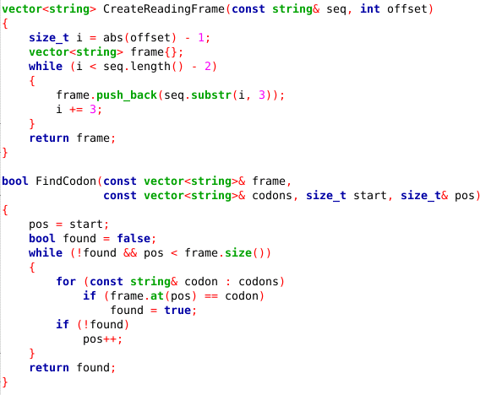
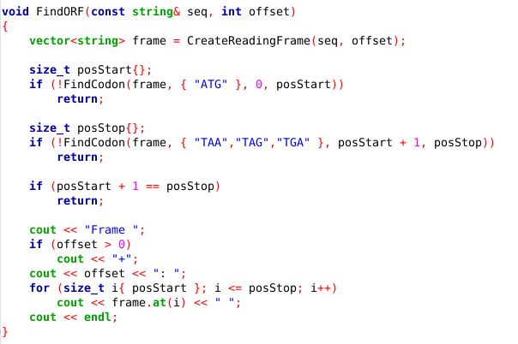
8. Finding an Open Reading Frame (ORF)

Slide 13
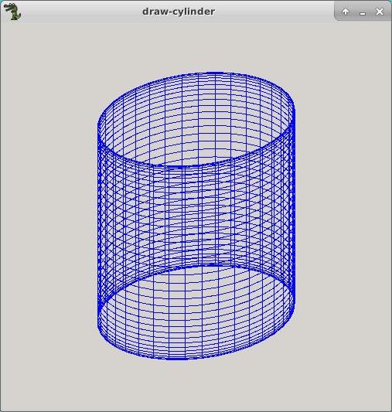
5 pts
9. Draw a 3D Cylinder
In the q09 folder, edit the C++ Allegro application to draw an open-ended 3D cylinder with radius 100 and length 200
Make it a wireframe drawing.
No back face culling or
facet shading is required.

Slide 14
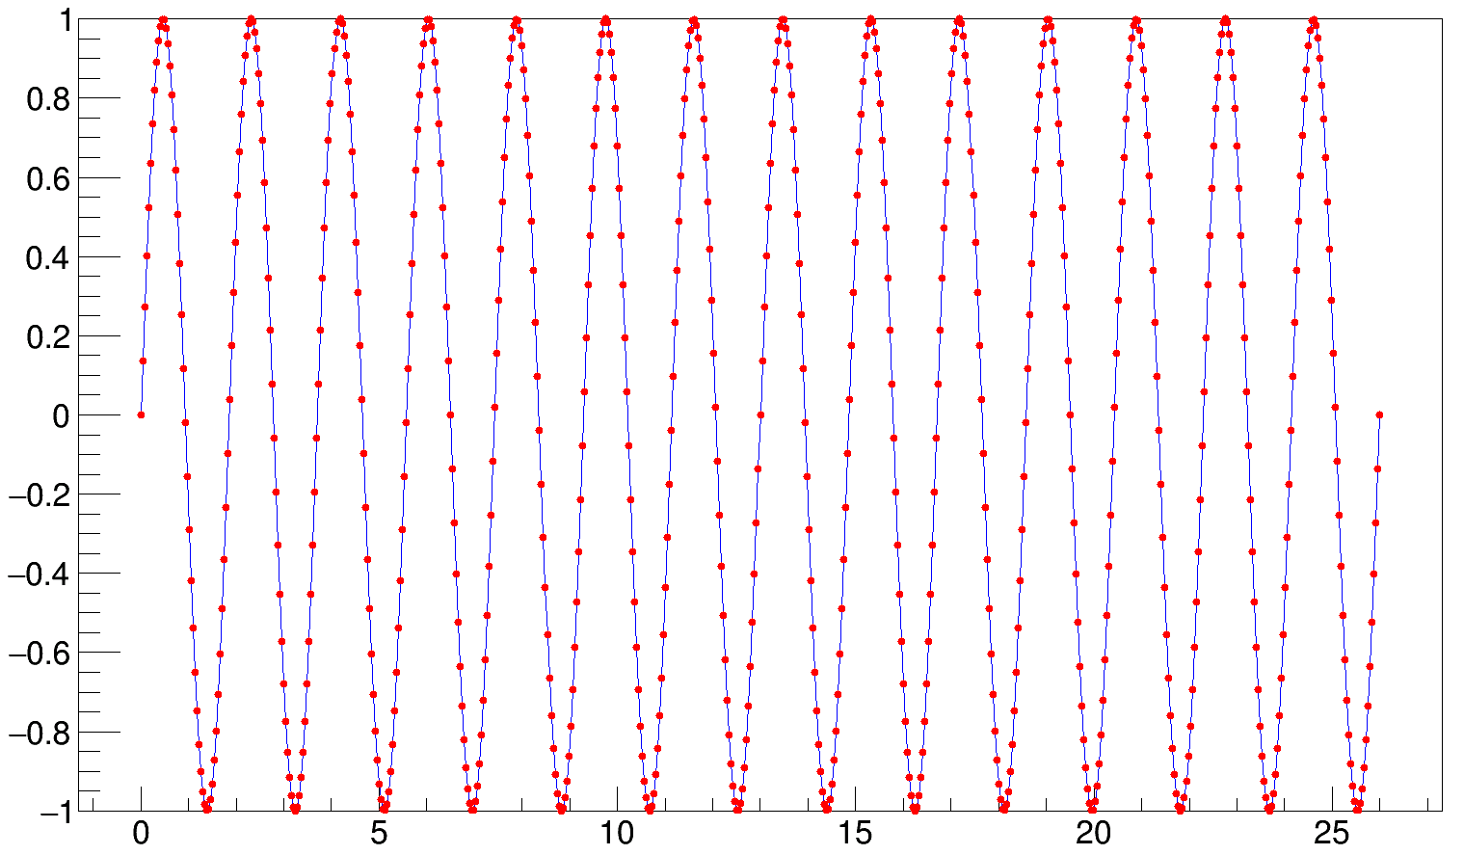
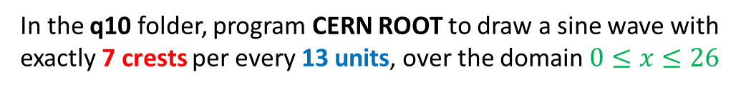
5 pts
10. Sample a Sinusoid
In the q10 folder, program CERN ROOT to draw a sine wave with exactly 7 crests per every 13 units, over the domain $0≤x≤26$

